Slide 1
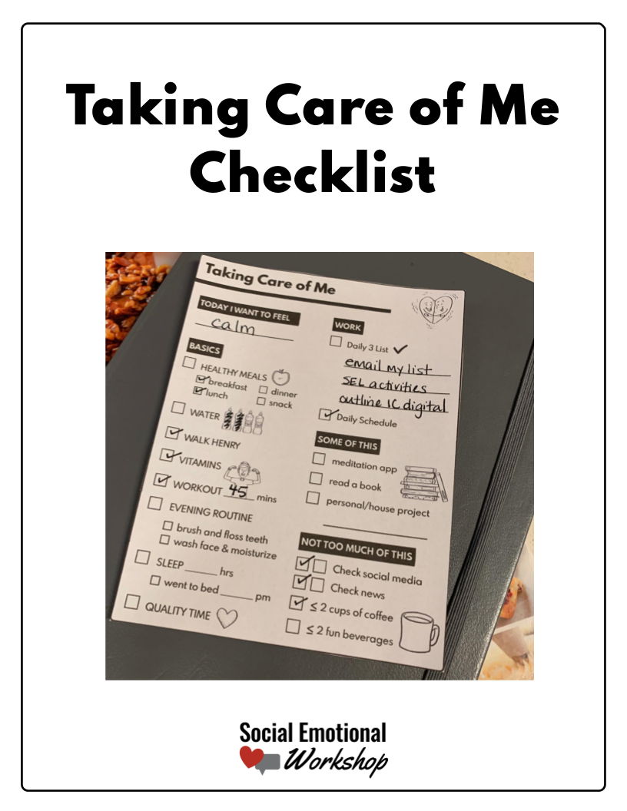

Slide 2
Taking Care of Me Checklist
In uncertain and new times, it is helpful to focus on what you can control. One of those things is your own self-care. Setting up routines and making sure you are taking care of yourself is important for your mental health. It is especially important when you are responsible for others, including your students and your own family.
I hope this small tool will help you find your daily routines and habits that will keep you healthy and calm through these difficult times.
Take care of yourself,
Laura
Editing
The included checklists are completely editable and currently have the habits I set for myself. You can edit to include the habits that you want to focus on. Be mindful that the formatting of the boxes and text is not locked.
Printing
You will notice there are 4 pages of the my checklist. This is for printing purposes. You can elect on your printer to print pages 3-7 and print 4 to a page. This will create a ¼ page checklist rather than a full page.
Daily 3
Most of the sections are self-explanatory. One section that might be new is Daily 3 List. Each day I pick 1-3 small things I want to get done that day. If I get those done, success!
Please contact me with any questions, concerns, or request. Laura@socialemotionalworkshop.com
If you are not already on my email list, please join for access to the free resource library, weekly emails, and resource discounts.
© Social Emotional Workshop

Slide 3
Daily Healthy Habits
BASICS
Healthy meals
Vitamins
Morning routines
Water
What’s your morning routine?
Sleep
How many hours do you want to sleep?
What time should you go to bed?
Evening routines
What’s your evening routine?
Physical activity
Quality Time
What physical activity can you do each day? Go for a walk, do yoga?
How can you spend time with the people you care about today?
What other things do you think you should do every day?
© Social Emotional Workshop

Slide 4
More of This, Less of This
MORE OF THIS
Calming activity
A personal project
Read
Reach out to someone
Journal
Fun activity
What are other positive activities you can add to your day?
LESS OF THIS
Social Media
Sugar
News
Alcohol
Coffee
Screentime
What are some activities you think you should do less of?
© Social Emotional Workshop

Slide 5
Taking Care of Me
TODAY I WANT TO FEEL
WORK
DAILY SCHEDULE
BASICS
DAILY 3 LIST
HEALTHY MEALS
breakfast
snack
lunch
dinner
WATER
SOME OF THIS
SLEEP ___ hrs
meditation app
I went to bed at ___ pm
read
WORKOUT
personal project
reached out to someone
QUALITY TIME
VITAMINS
LESS OF THIS
WALK THE DOG
Check social media
EVENING ROUTINE
Check news
brush teeth & floss
screen time
wash face & moisturize
sweets, alcohol, etc

Slide 6
Taking Care of Me
TODAY I WANT TO FEEL
WORK
DAILY SCHEDULE
BASICS
DAILY 3 LIST
HEALTHY MEALS
breakfast
snack
lunch
dinner
WATER
SOME OF THIS
SLEEP ___ hrs
meditation app
I went to bed at ___ pm
read
WORKOUT
personal project
reached out to someone
QUALITY TIME
VITAMINS
LESS OF THIS
WALK THE DOG
Check social media
EVENING ROUTINE
Check news
brush teeth & floss
screen time
wash face & moisturize
sweets, alcohol, etc

Slide 7
Taking Care of Me
TODAY I WANT TO FEEL
WORK
DAILY SCHEDULE
BASICS
DAILY 3 LIST
HEALTHY MEALS
breakfast
snack
lunch
dinner
WATER
SOME OF THIS
SLEEP ___ hrs
meditation app
I went to bed at ___ pm
read
WORKOUT
personal project
reached out to someone
QUALITY TIME
VITAMINS
LESS OF THIS
WALK THE DOG
Check social media
EVENING ROUTINE
Check news
brush teeth & floss
screen time
wash face & moisturize
sweets, alcohol, etc

Slide 8
Taking Care of Me
TODAY I WANT TO FEEL
WORK
DAILY SCHEDULE
BASICS
DAILY 3 LIST
HEALTHY MEALS
breakfast
snack
lunch
dinner
WATER
SOME OF THIS
SLEEP ___ hrs
meditation app
I went to bed at ___ pm
read
WORKOUT
personal project
reached out to someone
QUALITY TIME
VITAMINS
LESS OF THIS
WALK THE DOG
Check social media
EVENING ROUTINE
Check news
brush teeth & floss
screen time
wash face & moisturize
sweets, alcohol, etc

